Slide 1











ANALYTICS FOR UNSTRUCTURED DATA Large Language Models: Attention and the Transformer MSBA Fall 2023 28th September
Dr. Anitesh Barua
David Bruton Jr. Centennial Chair Professor of Business
Distinguished Fellow, INFORMS Information Systems Society
Stevens Piper Foundation Professor
University of Texas Distinguished Teaching Professor
McCombs School of Business, University of Texas at Austin
Email: anitesh.barua@mccombs.utexas.edu

Slide 2
Recurrent Neural Networks (RNN)
A major leap in NLP
Can generate text from input prompts
Considers previous input words to predict the next word
Limitation of earlier models: Small window of words
Improvement with Long Short Term Memory (LSTM)
Transformers offer a superior architecture

Slide 3
Attention (or Self-Attention)
The history of word representations
Bag-of-word representations (e.g., term frequency, tf-idf, etc.)
Word embeddings
Self-attention
“The cat didn’t chase the mouse because it wasn’t hungry”
Or “The deer didn’t cross the road since it was too tired.”
What do the word “it”, “hungry” and “tired” refer to?

Slide 4
Attention a Key Element of Transformers
An architecture by Google using attention
Parallelization, faster training
Seminal paper: “Attention is All You Need”
Implementations
Tensor2Tensor
PyTorch

Slide 5
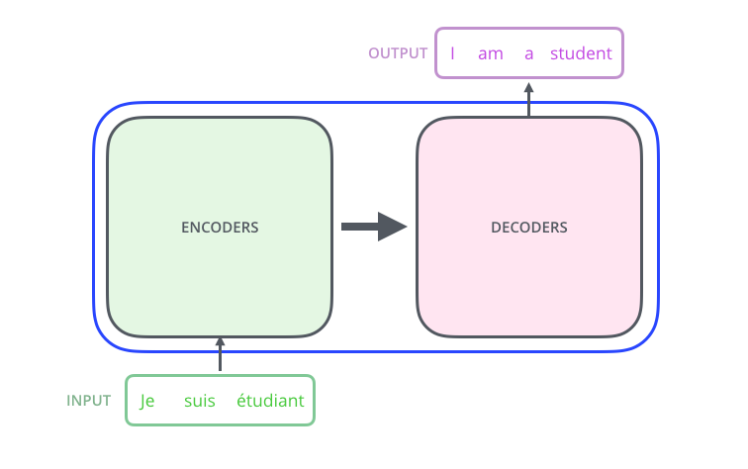
The Trained Transformer Model
http://jalammar.github.io/illustrated-transformer/

Slide 6
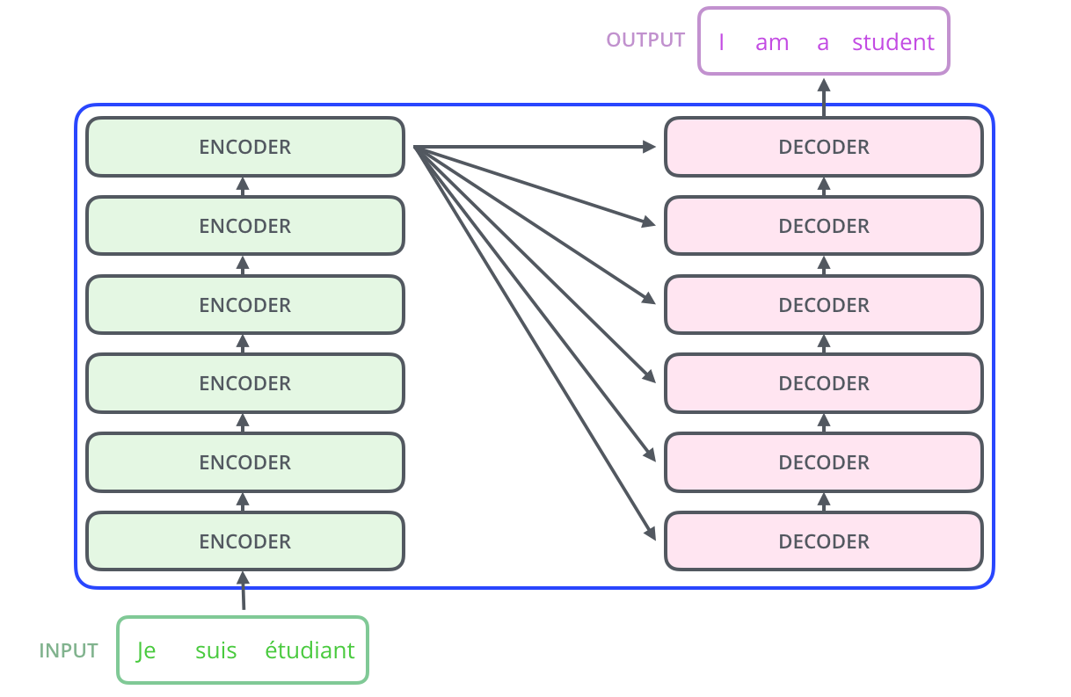
Stack ‘em High!
http://jalammar.github.io/illustrated-transformer/

Slide 7
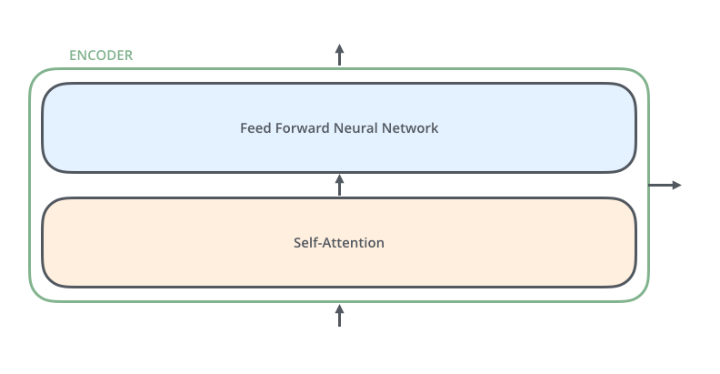
2-step Encoding
http://jalammar.github.io/illustrated-transformer/

Slide 8
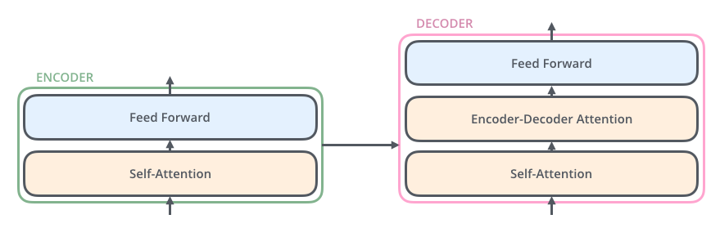
An Extra Attention Layer in the Decoder
http://jalammar.github.io/illustrated-transformer/

Slide 9
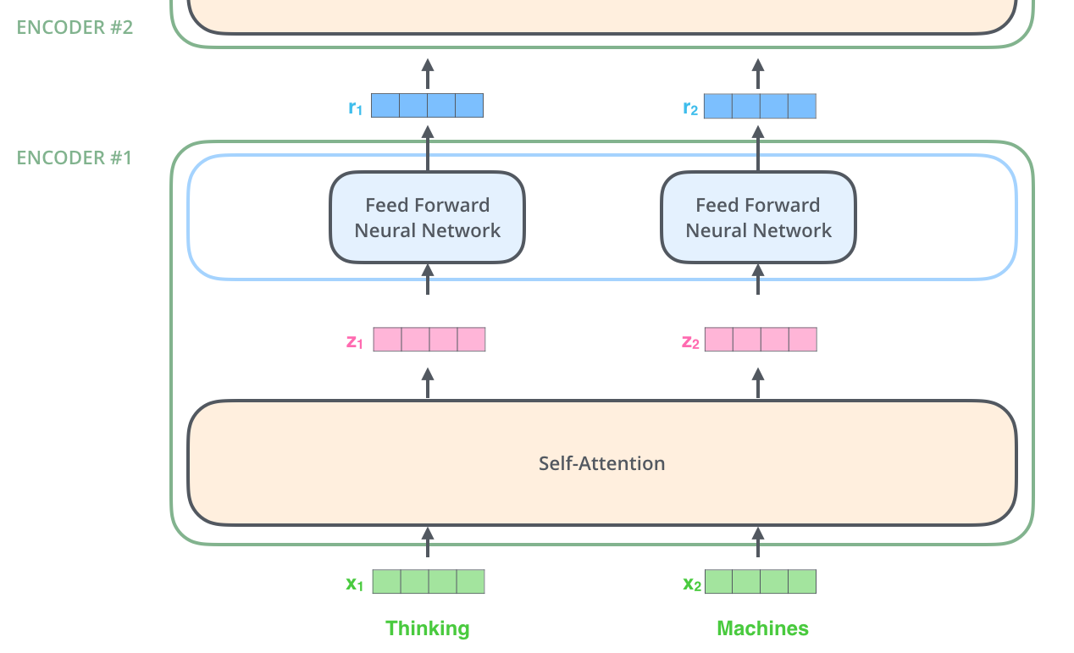
The Output of an Encoder
http://jalammar.github.io/illustrated-transformer/

Slide 10
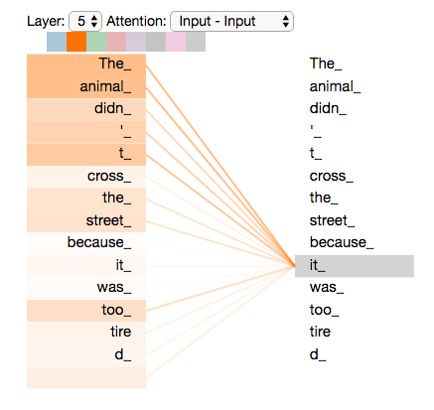
The Concept of Self-attention
http://jalammar.github.io/illustrated-transformer/

Slide 11
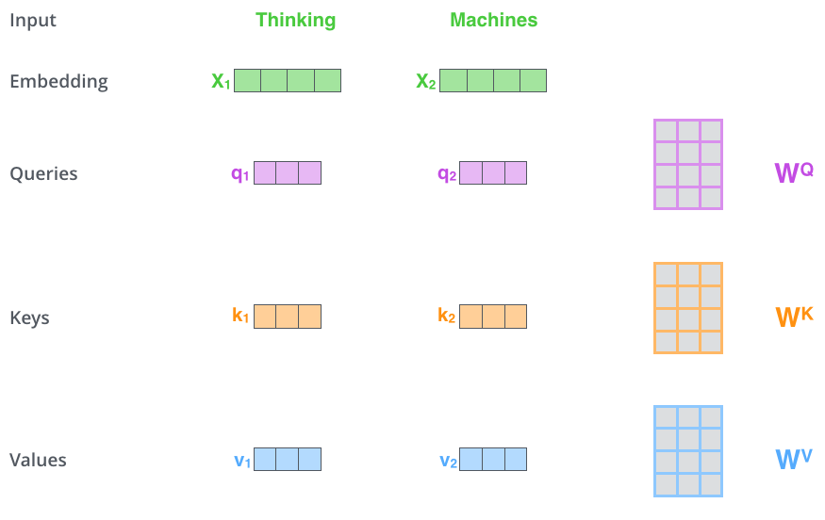
Queries, Keys, and Values
http://jalammar.github.io/illustrated-transformer/

Slide 12
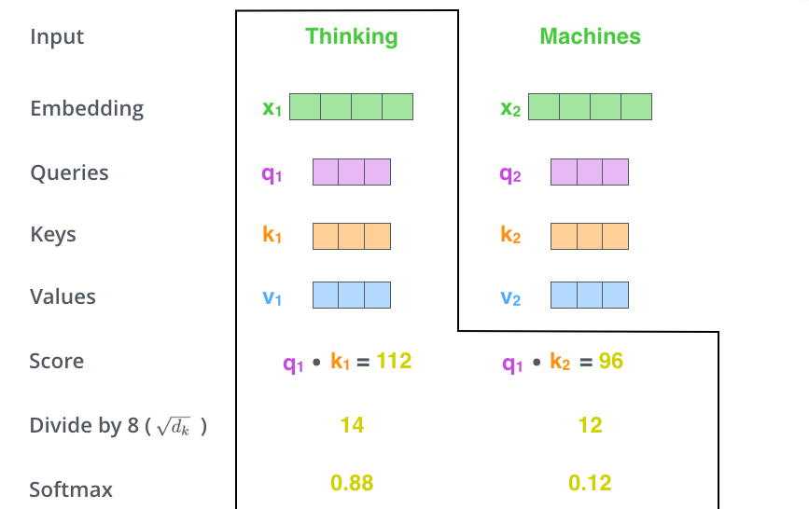
Calculating Attention
http://jalammar.github.io/illustrated-transformer/

Slide 13
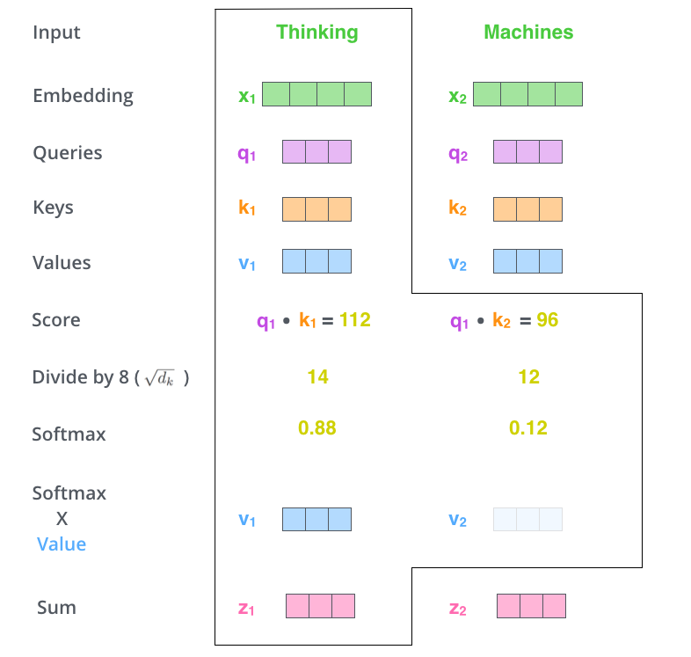
More Calculations
http://jalammar.github.io/illustrated-transformer/

Slide 14
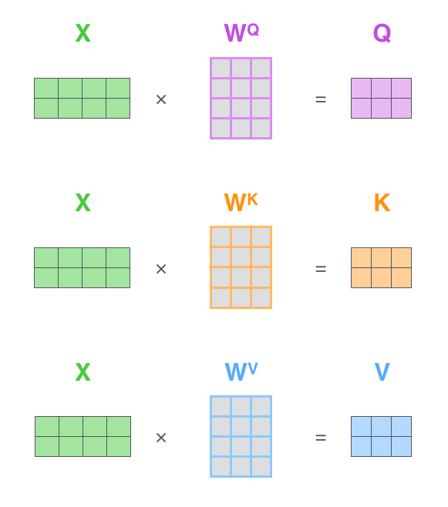
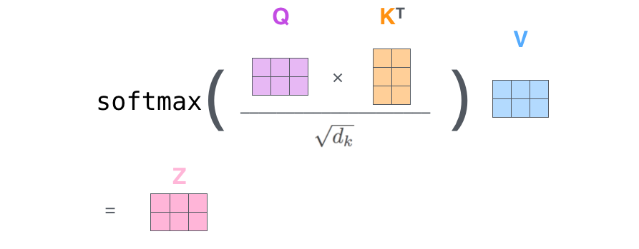
In Matrix Notation
http://jalammar.github.io/illustrated-transformer/

Slide 15
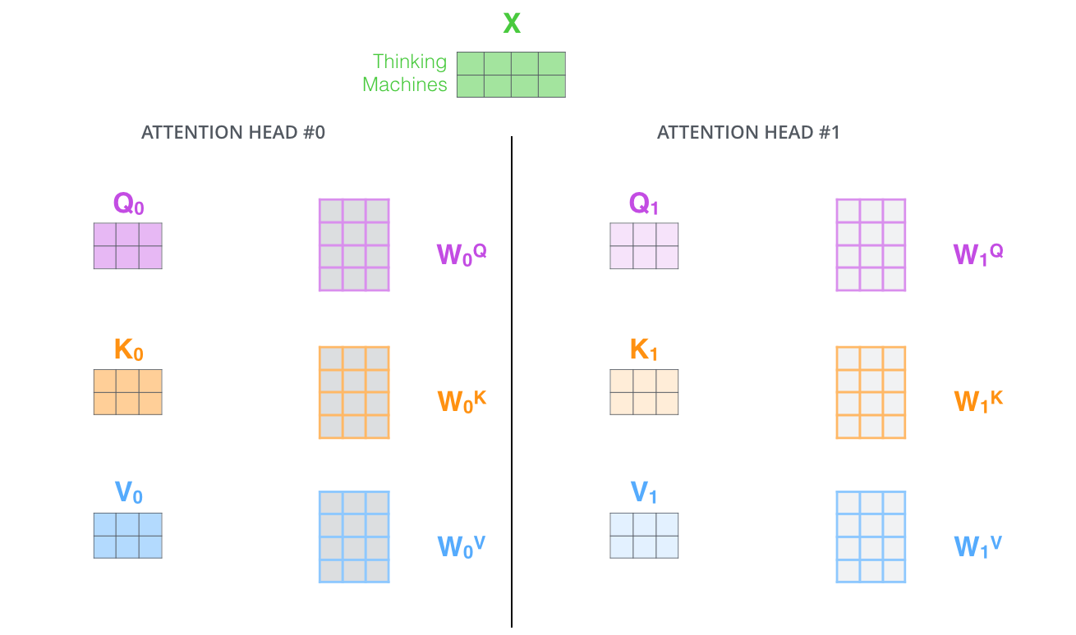
Multi-headed Attention
http://jalammar.github.io/illustrated-transformer/

Slide 16
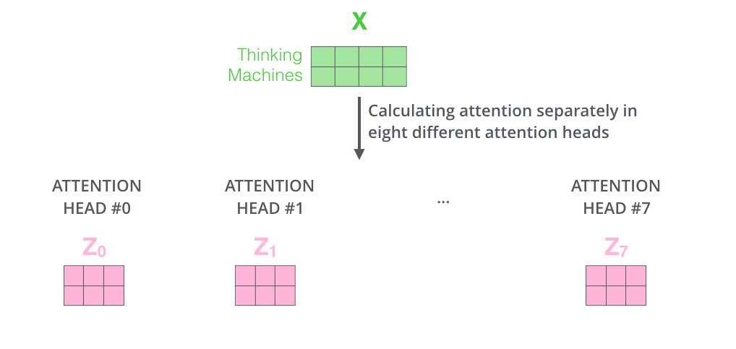
Multi-headed Attention Scores
http://jalammar.github.io/illustrated-transformer/

Slide 17
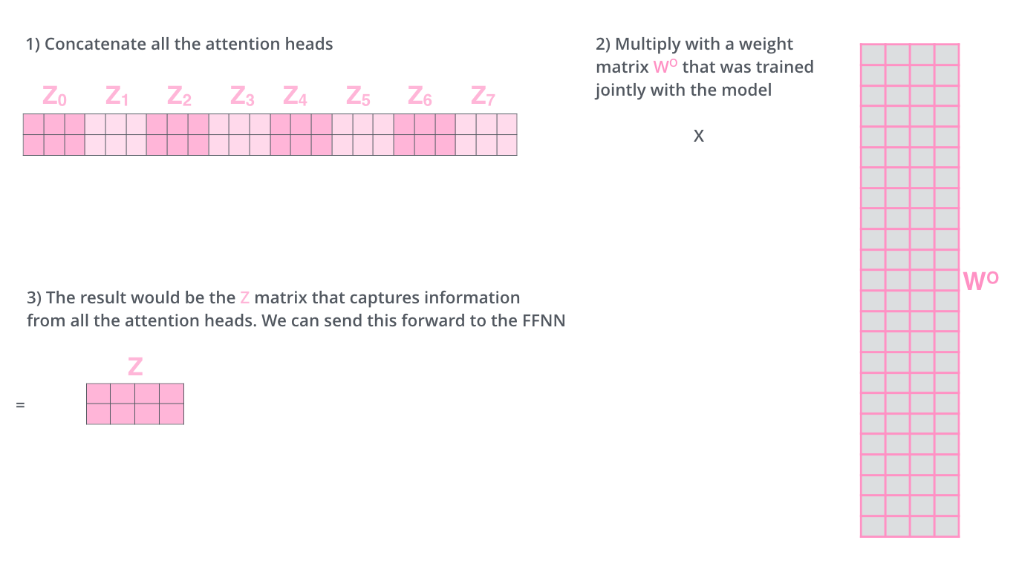
Multiple Attention Scores
http://jalammar.github.io/illustrated-transformer/

Slide 18
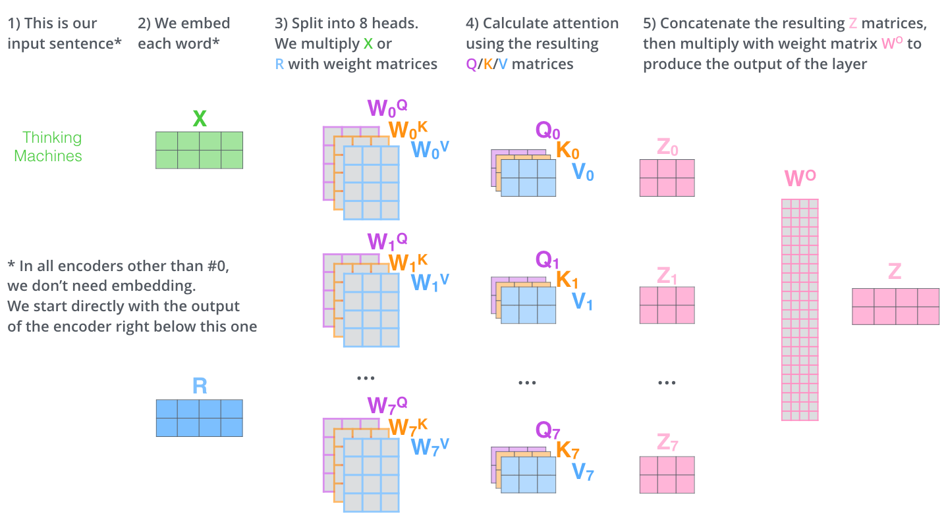
Summary
http://jalammar.github.io/illustrated-transformer/

Slide 19
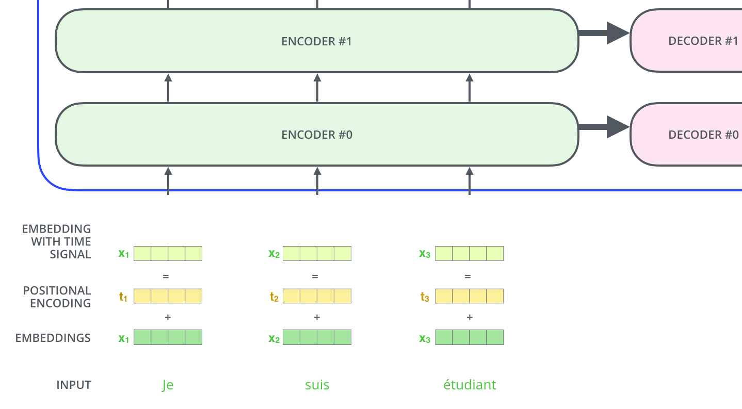
Positional Encoding
http://jalammar.github.io/illustrated-transformer/

Slide 20
Takeaways
Attention dramatically improves representation of words and their relationships
Using attention, transformers provided a breakthrough in NLP
Achieved state-of-the-art performance
Has been used in a variety of LLMs such as BERT, GPT, and others

